Slide 1
TRANSPORT DEMAND PREDICTION
K.MAMATHA
221FA14007
SEC:A
BI

Slide 2

BUISSNESS OBJECTIVE
TRANSPORT DEMAND PREDICTION ANALYSIS
Build a transport demand prediction analysis

Slide 3

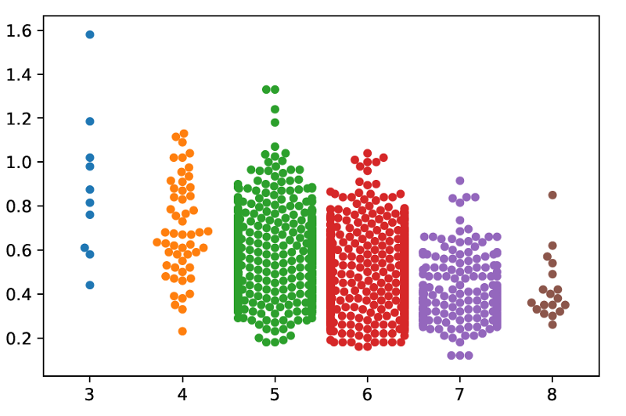
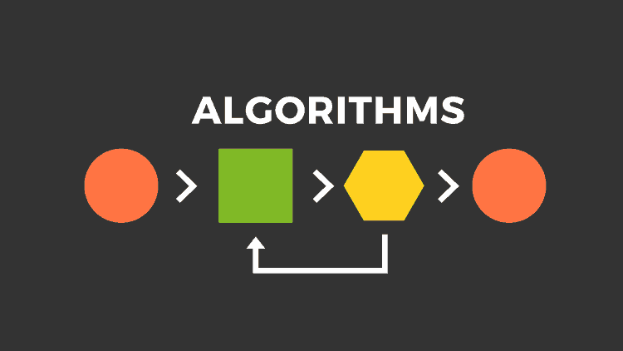
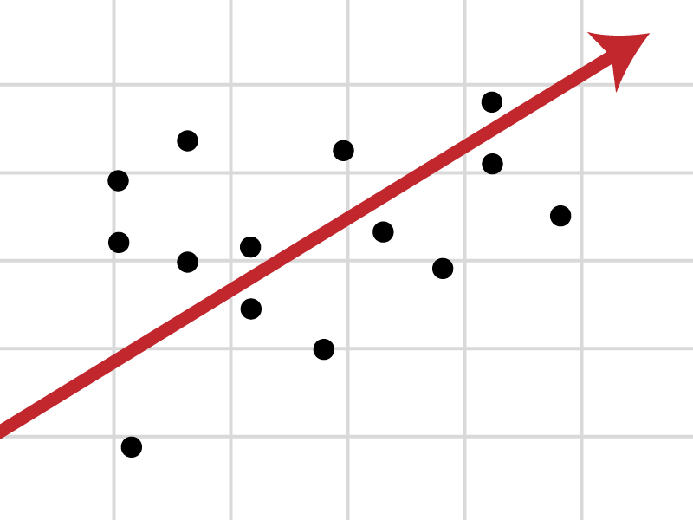
Approach
Data Preparation
and
Exploratory Data Analysis
Building Predictive Model
using Multiple
Techniques / Algorithms
Optimal Model Identified
through
Testing and Evaluation

Slide 4
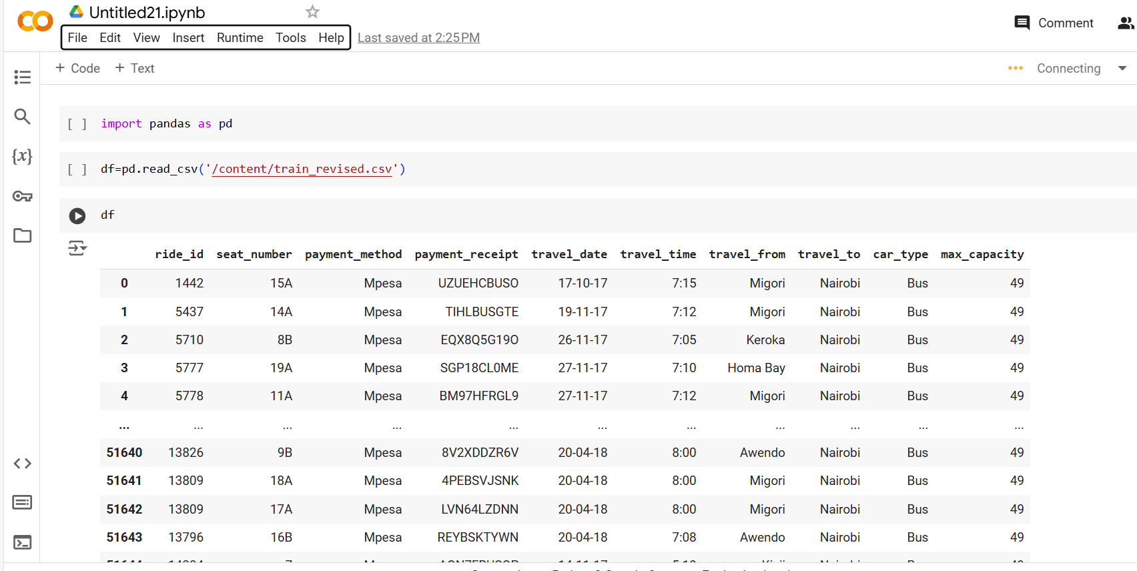
Data Preparation and EDA
First, begin with setting our path and importing required packages and also read the dataset

Slide 5
We have some features with “object” dtype and quite surprising to see that no Null Values.
The dataset contains the following columns:
ride_id: A unique identifier for each ride.
seat_number: The seat number of the passenger.
payment_method: The method of payment (e.g., Mpesa).
payment_receipt: The receipt number for the payment.
travel_date: The date of the ride (in DD-MM-YY format).
travel_time: The time of the ride (in HH
format).
travel_from: The location where the ride originates (e.g., Migori, Keroka, etc.).
travel_to: The destination of the ride (e.g., Nairobi).
car_type: The type of vehicle used (e.g., Bus).
max_capacity: The maximum capacity of the vehicle.

Slide 6
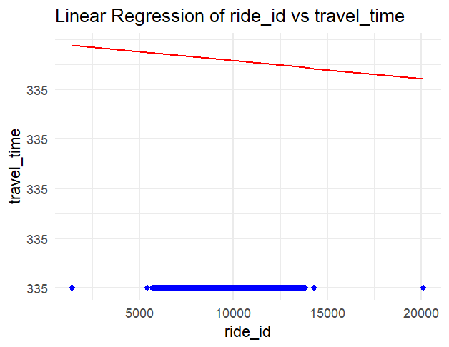
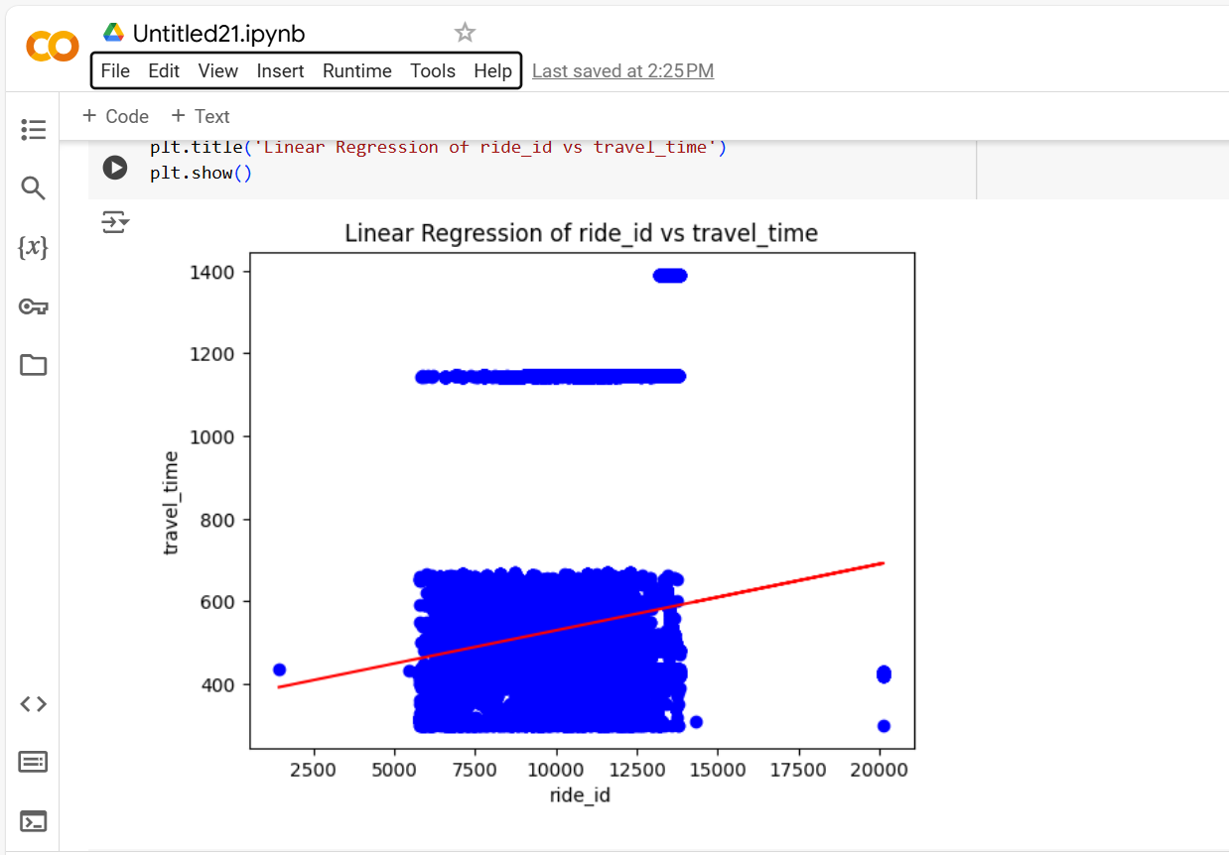
.
RESULTS OF TRANSPORT DEMAND PREDICTION DATASET ANALYSIS
RIDEID VS TRAVEL TIME
Data: The dataset contains ride_id and travel_time fields.
If travel_time is in HHformat, it is converted into minutes.
Scatter Plot: The graph is created with ride_id on the x-axis and travel_time_in_minutes on the y-axis.

Slide 7
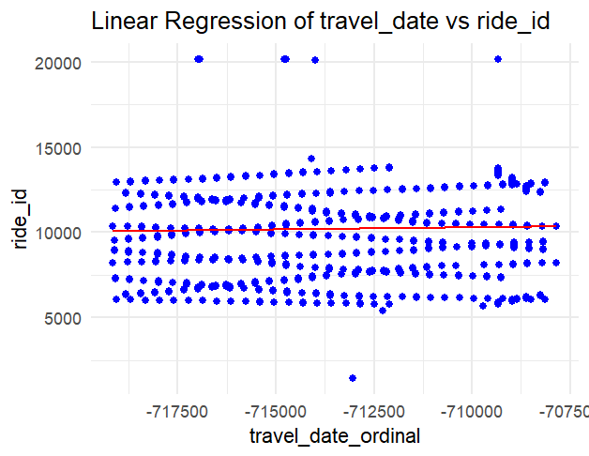
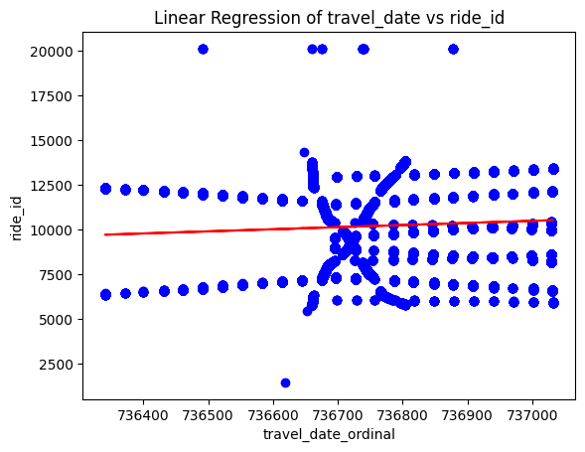
RIDE ID TRAVEL DATE
Date Conversion: In both scripts, travel_date is converted into a date format (datetime in Python, Date in R) to make it suitable for plotting.
Scatter Plot: The scatter plot is drawn with travel_date on the x-axis and ride_id on the y-axis.
Customization: The x-axis labels are rotated for better readability

Slide 8
Hyperparameter Tuning
Hyperparameter tuning is the process of selecting the optimal set of hyperparameters for a machine learning model to improve its performance. Hyperparameters are parameters that control the learning process and are set before training the model, unlike model parameters (e.g., weights in a neural network) which are learned during training
Common Hyperparameters to Tune:
Learning rate: Controls how much to adjust the model in response to the estimated error each time the model weights are updated.
Regularization strength (e.g., L1, L2): Controls the complexity of the model by penalizing large weights.
Number of layers/neurons: In neural networks, this controls the depth and size of the model.
Max_depth and min_samples_split: In decision trees and random forests, these control tree size and pruning.
Kernel type and gamma: In SVMs, kernel functions and their parameters are critical.
Number of estimators: In ensemble methods like Random Forest or Gradient Boosting, this refers to the number of trees or models used.

Slide 9
CONCLUSION
Overall, this dataset has rich information that could help analyze travel demand patterns, payment behavior, vehicle utilization, and travel route efficiency. Depending on the goals, further analysis like regression modeling (e.g., ride_id vs travel_time) could reveal specific trends or correlations.
For a more precise conclusion, I would suggest running some specific analyses, such as:
Time-series analysis of ride frequency by travel_date.
Clustering or classification based on routes or payment preferences.
Regression analysis to study correlations between travel times, ride IDs, and other factors.

Slide 10


